Slide 1
Security Model
Lecturer: Ngo Huy Bien
Software Engineering Department
Faculty of Information Technology
VNUHCM - University of Science
Ho Chi Minh City, Vietnam
nhbien@fit.hcmus.edu.vn

Slide 2

Objectives
To configure Salesforce security settings.

Slide 3

Contents
Salesforce Security Concepts.
Profiles.
Permission Sets.
Roles.
Public Groups.
Org Sharing Rules.
Custom Sharing Rules.
Object Permissions.
Field Permissions.
MFA and Authenticators.

Slide 4

References

Slide 5
Salesforce Security Concepts (I)
An authorization rule contains 3 basic elements:
a resource,
a principle and
an operation (or action).
A Salesforce resource can be
an Object, or
a Record, or
a Field.

Slide 6
Salesforce Security Concepts (II)
A Salesforce principle can be
an ORG, or
a Role, or
a Group, or
a User.
A Salesforce User can be an Internal User or an External User.
An internal user logs in to Salesforce via login.salesforce.com or a company myDomain, like salesforce.acme.com, using an internal license. Internal users primarily access the Salesforce platform using Lightning Experience or Salesforce Classic.
A user with an external license can access only the Experience Cloud sites that the user is a member of. An external user can’t access the internal Lightning Experience or Salesforce Classic.

Slide 7
Salesforce Security Concepts (III)
A Salesforce operation (or action) can be
View, and/or
Edit, and/or
Delete, and/or
Private: Only users who are granted access by ownership, permissions, role hierarchy, manual sharing, or sharing rules can access the records.
Public Read Only: All users can view all records for the object.
Public Read/Write: All users can view and edit all records for the object.
Controlled by Parent: Users can perform actions (such as view, edit, delete) on a record on the detail side of a master-detail relationship if they can perform the same action on all associated master records.

Slide 8
Salesforce Security Concepts (IV)
An authorization rule is a combination of a resource, a principle and an operation that is used to determine whether a principal is allowed to perform an operation against a resource.
Salesforce Sharing Defaults, or Sharing Rule, or Profile or Permission Set is a collection of authorization rules.

Slide 9
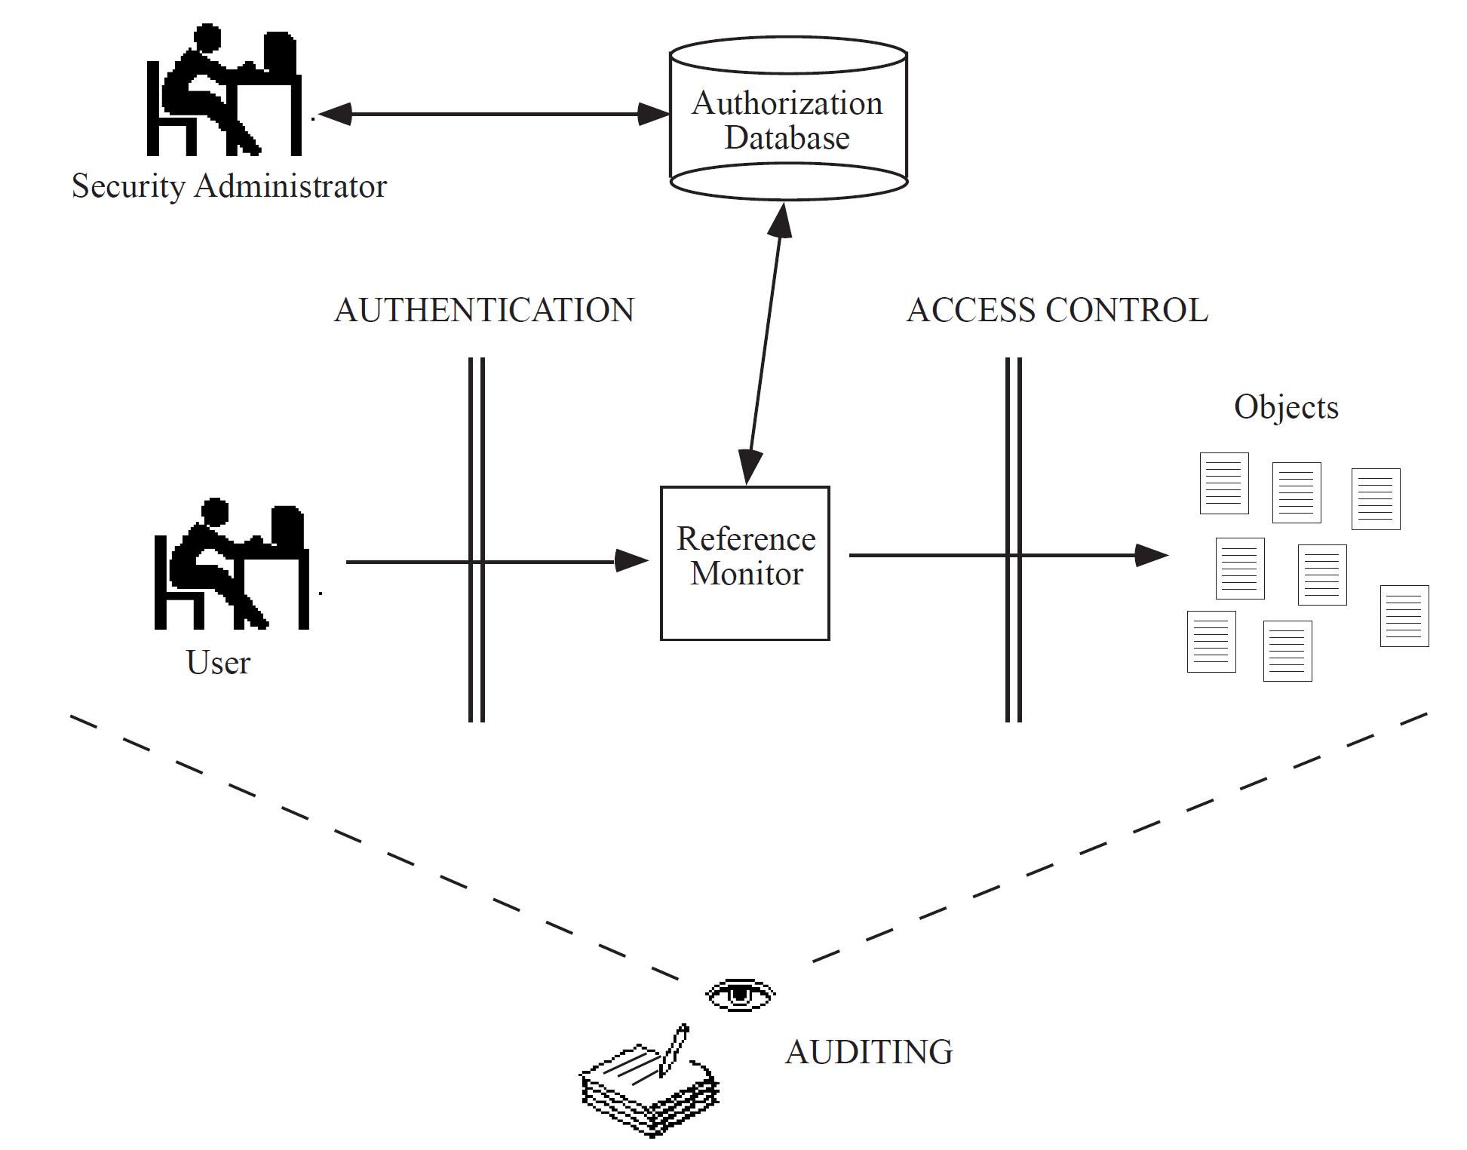
Access Control

Slide 10


Slide 11
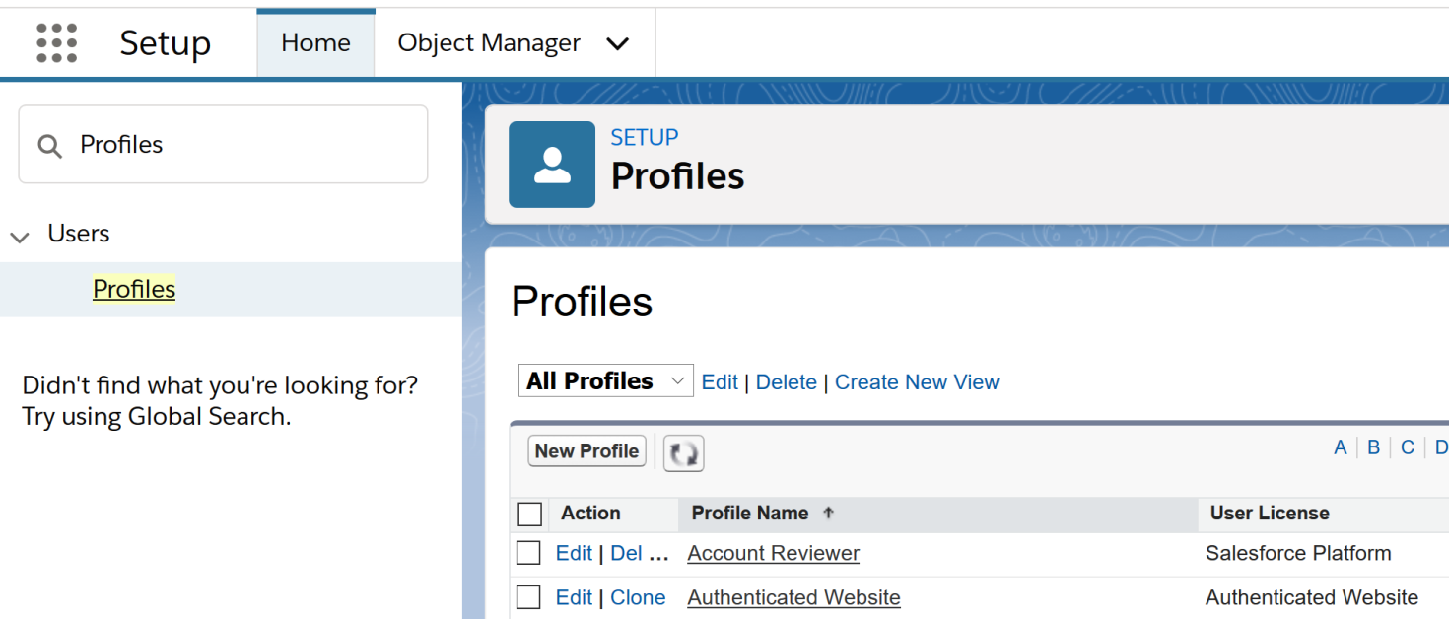
1. Manage Profiles
Profiles are used to specify what users assigned to that Profile can do within the instance.
This includes password policies, hours during which users can log in, locations from which they can log in, which objects and fields they can access.
Go to Setup → Profiles to create, edit or delete a Profile.

Slide 12
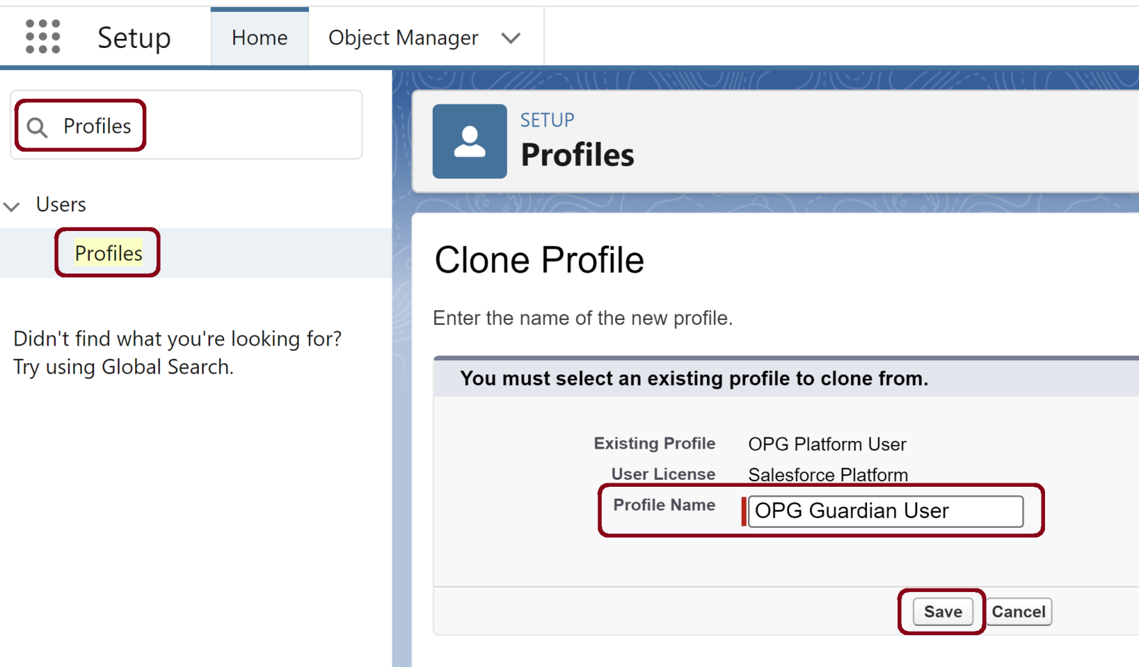
2. Clone a Profile

Slide 13
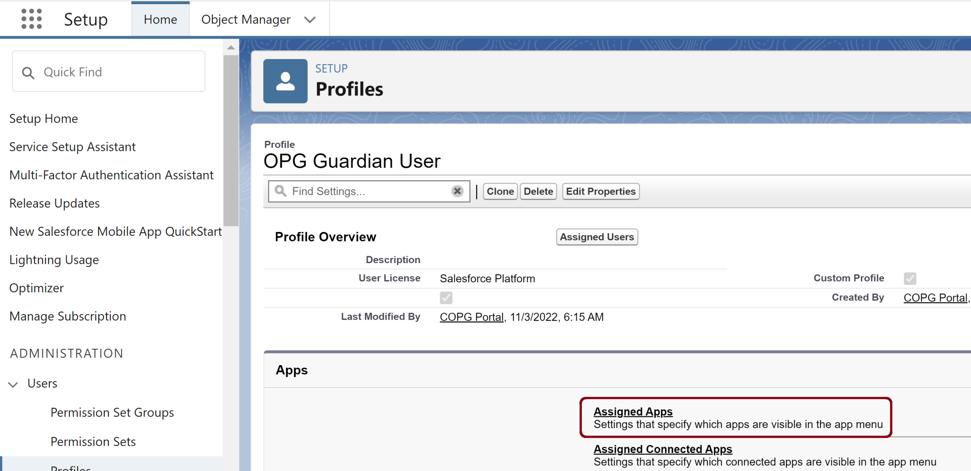
3. Configure Profile Assigned Apps

Slide 15
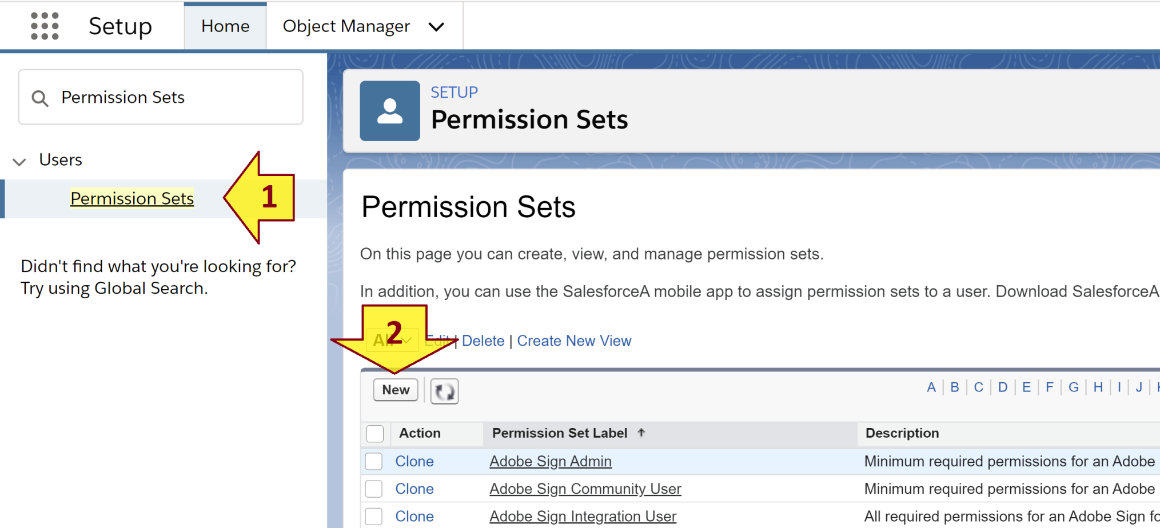
1. Manage Permission Sets
The difference between a Permission Set and a Profile is that many Permission Sets can be assigned to specific user while only one Profile can be assigned to the user.
Go to Setup → Permission Sets to create, edit or delete a Permission Set.

Slide 17
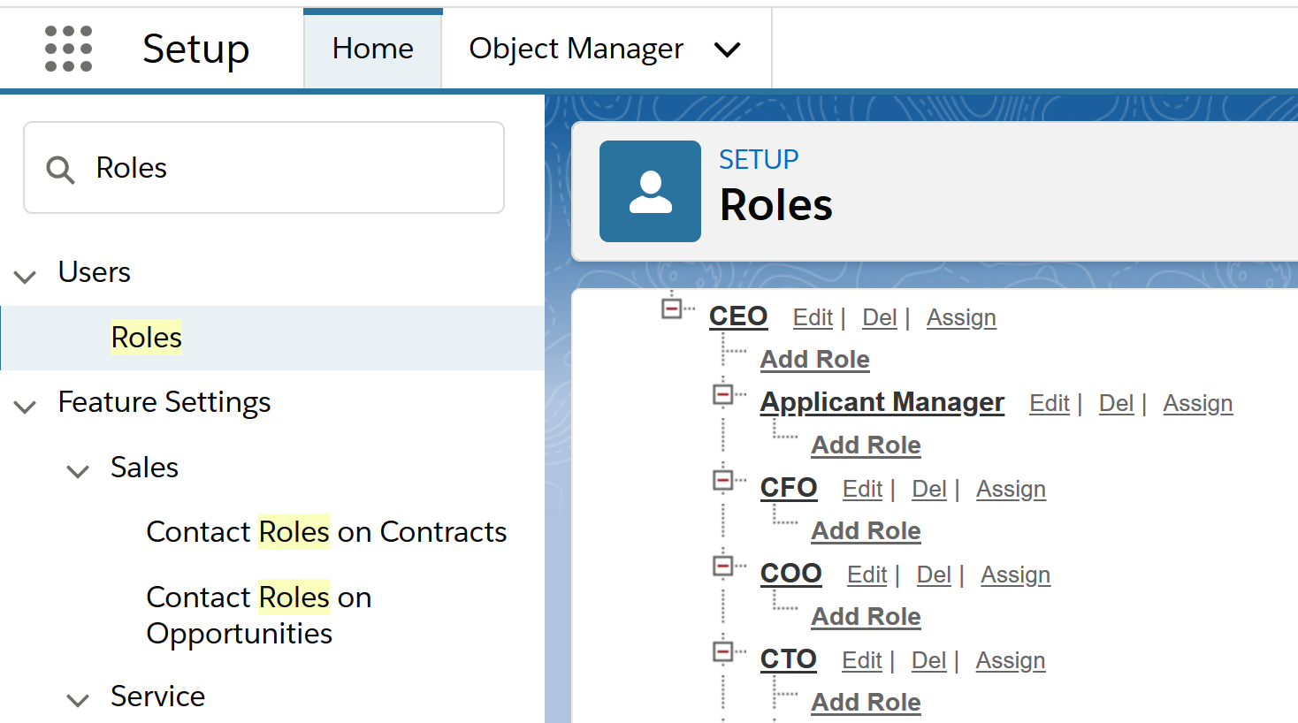
1. Manage Roles
Roles in the role hierarchy should be created as “functional” rather than “real,” meaning that administrative assistants should be placed above their bosses in the hierarchy.
Go to Setup → Roles to create, edit or delete a Role.

Slide 18
Roles vs. Profiles
Role defines what user is permitted to see depending on the hierarchy. (Role helps in defining data visibility.)
Profile defines what a user is permitted to do within an ORG. (Profile defines various permissions.) These permissions include
Object permissions [create, delete, read, edit permissions]
Field permissions [view, edit]
Record type permission
Which Apps can be viewed
Login hours can be defined
IP address permissions
Which tabs are visible
Which page layouts can be viewed
Apex classes, VF pages permissions.
Defining profile for a user is mandatory, defining role is not.

Slide 19
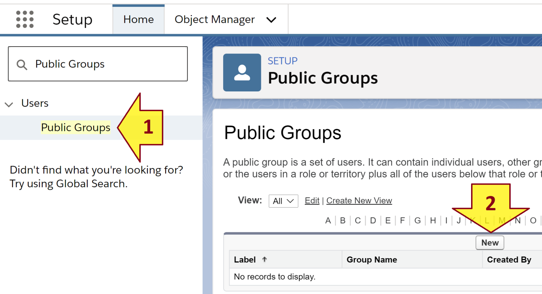
2. Manage Public Groups
The difference between a Public Group and a Role is that a User can have only a Role but can belong to multiple Groups.
Go to Setup → Public Groups to create, edit or delete a Public Group.

Slide 21
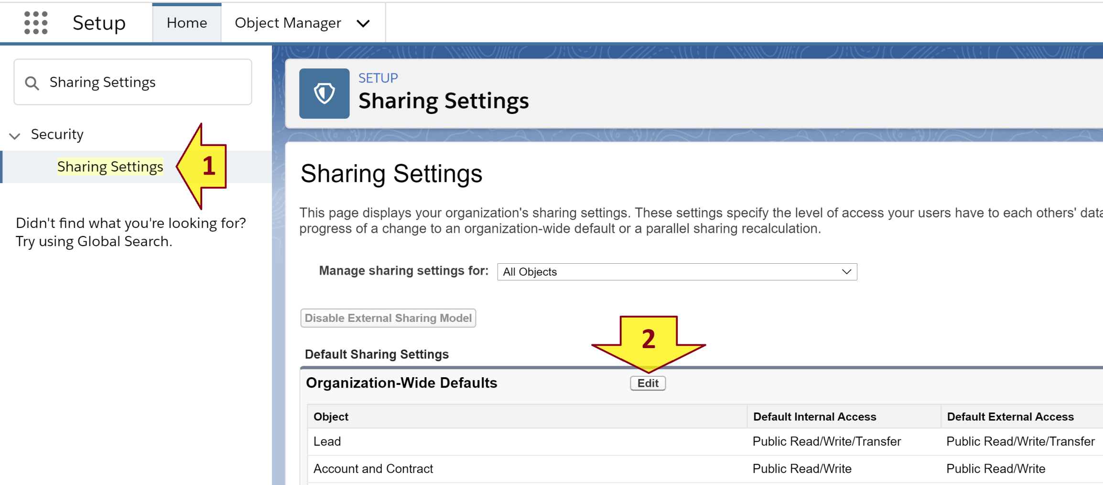
1. Manage Org Sharing Rules
Go to Setup → Sharing Settings.
Click the Edit button beside the Organization-Wide Defaults label.
Then we can make all Accounts Private for example, meaning that only the person who “owns” that record can see it.

Slide 22
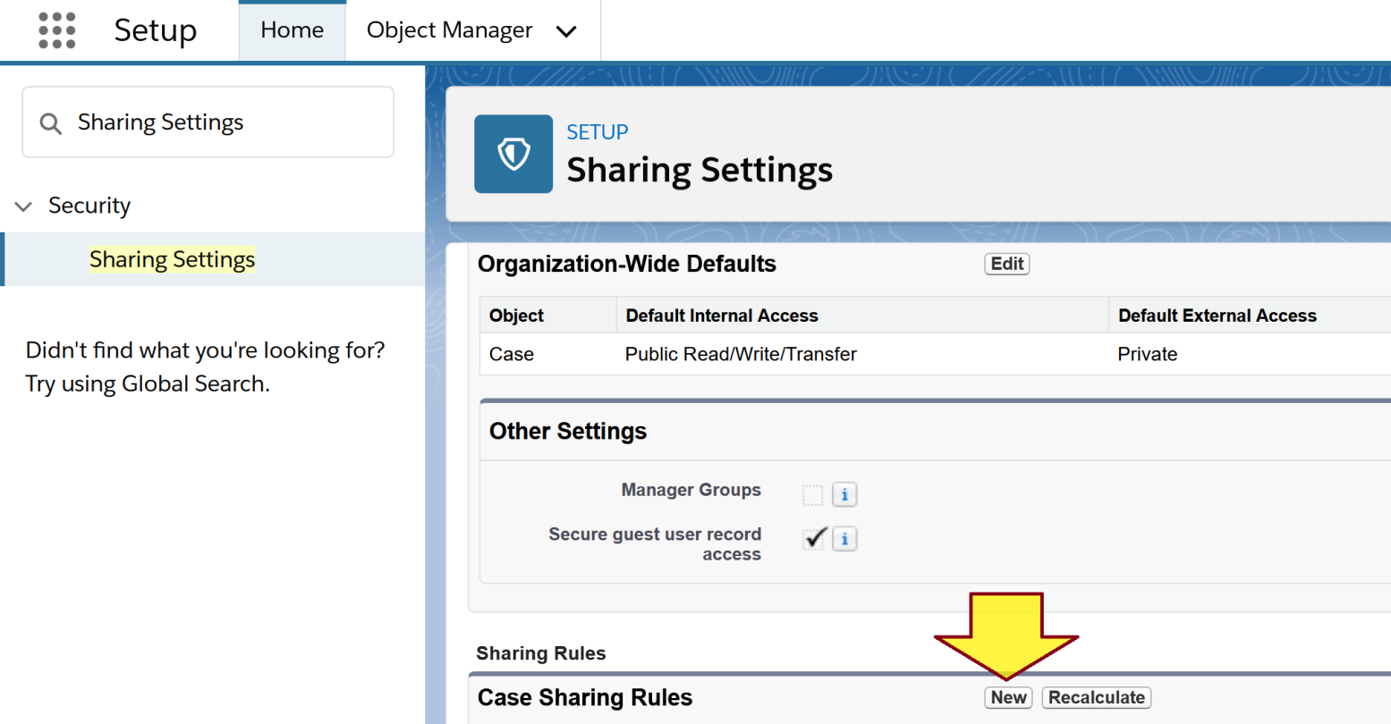
2. Create a Custom Sharing Rule
Go to Setup → Sharing Settings.
Click the New button beside the Case Sharing Rules label. Then we can customize Case permissions for Groups or Roles. (Please replace the Case object by any other object.)

Slide 23
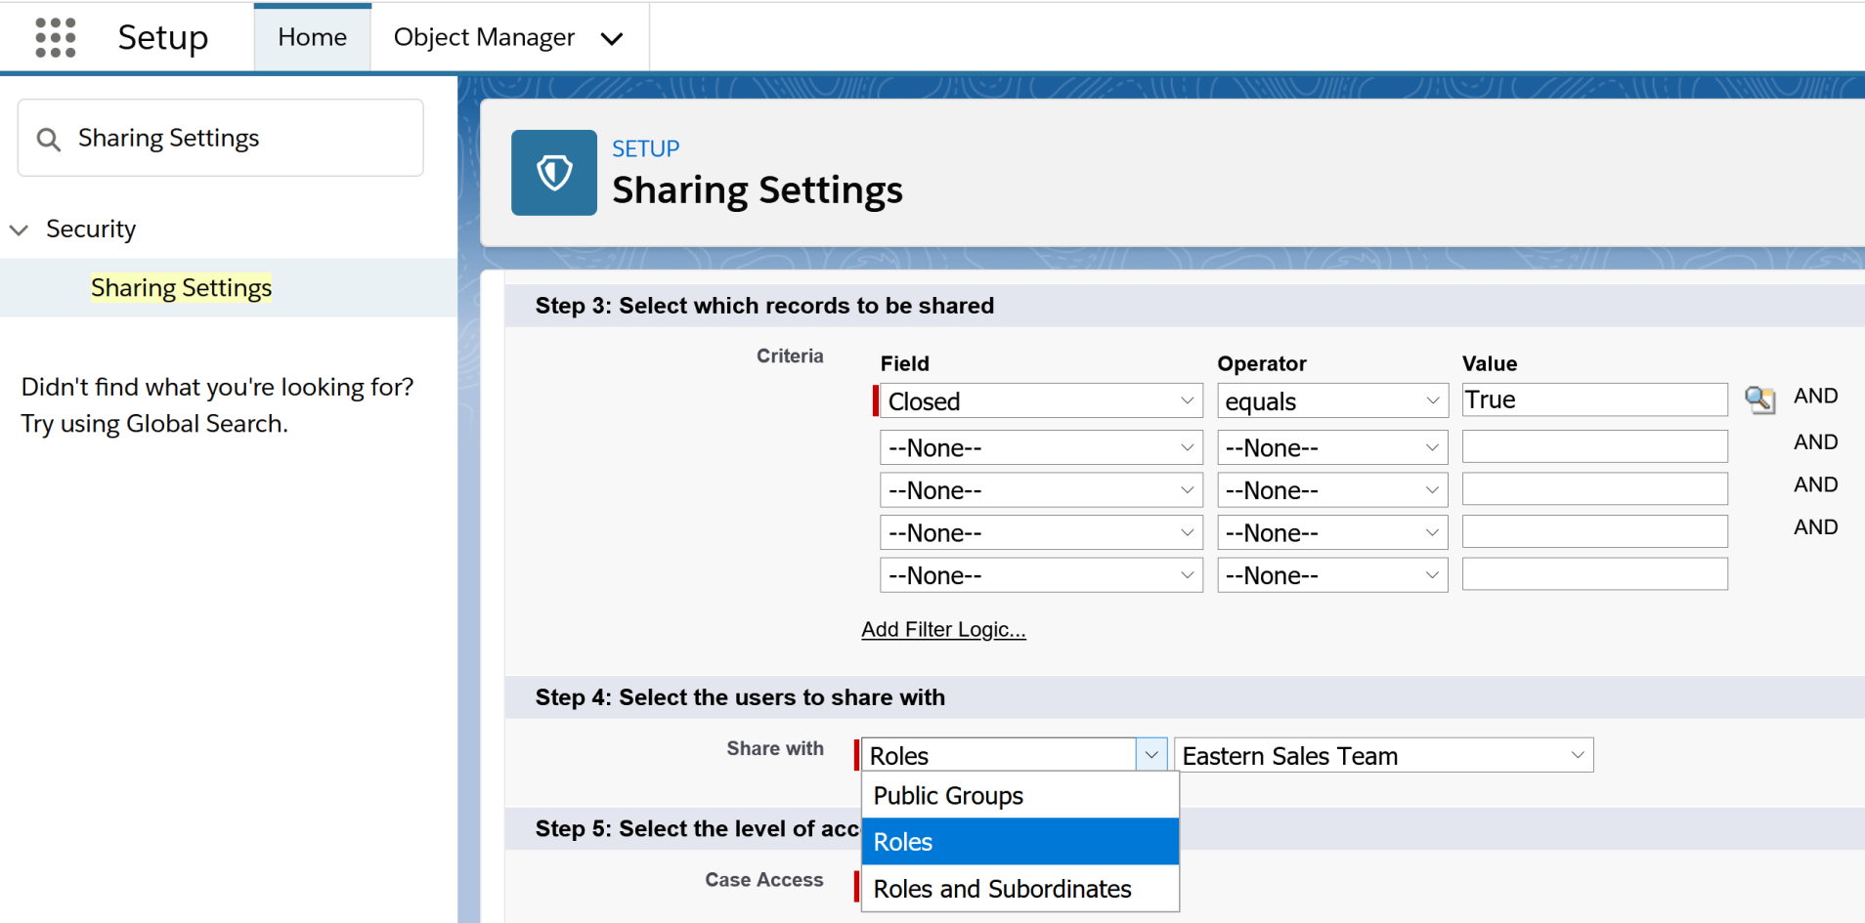
3. Configure Custom Sharing Rule
Select a Role or Group for configuring permissions.

Slide 25
User's Permissions
A user
must belong to an ORG (with Sharing Rules)
can have a Role,
must have a Profile,
can belong to multiple Public Groups and
can be assigned multiple Permission Sets.
Therefore to review all user’s permissions we need to review all the permissions that a defined in
the Sharing Rules,
the Role,
the Profiles,
the Public Groups, and
the Permission Sets
assigned to the User, including hierarchy of these permissions.

Slide 26
Company (ORG) Security Model
Log in Salesforce company (ORG) as administrator to review or document the company security model.
Basically we need to review or document
ORG Sharing Rules,
Roles,
Profiles,
Public Groups, and
Permission Sets.
users and their corresponding role, profile, groups and permission sets.
objects/fields and the corresponding role, profile, groups and permission sets related to them.

Slide 27
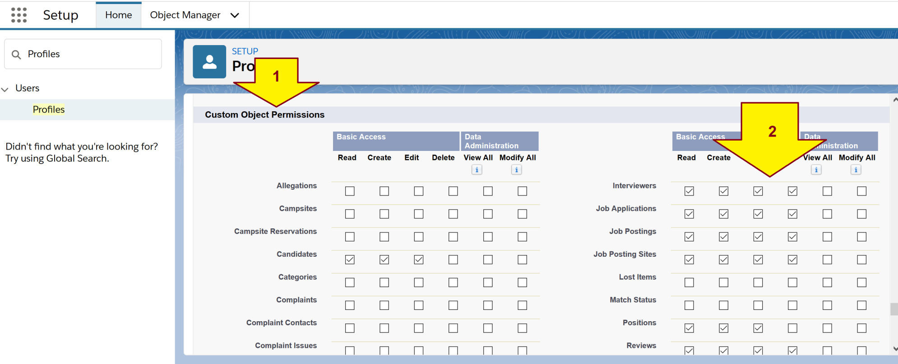
1. Review Object Permissions
Authorization rules: from a principle to objects.
Go to Setup → Profiles , click on a profile name.
Scroll down to the Custom Object Permissions section.

Slide 28
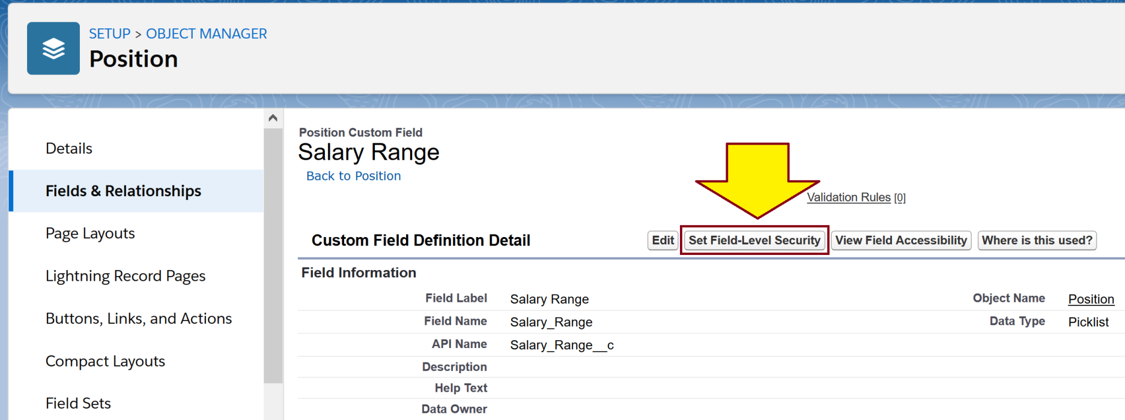
2. Review Field Permissions
Authorization rule: from object to principles.
Go to Setup → Object Manager , click on an object name.
Click Fields & Relationships, click a custom field label (not a built-in field label), click Set Field-Level Security button.

Slide 29
3. Review Field Permissions using the Welkinsuite
This IDE allows editing field-level security for multiple profiles in one window.
https://www.youtube.com/watch?v=PC1FffI5Pa0

Slide 31
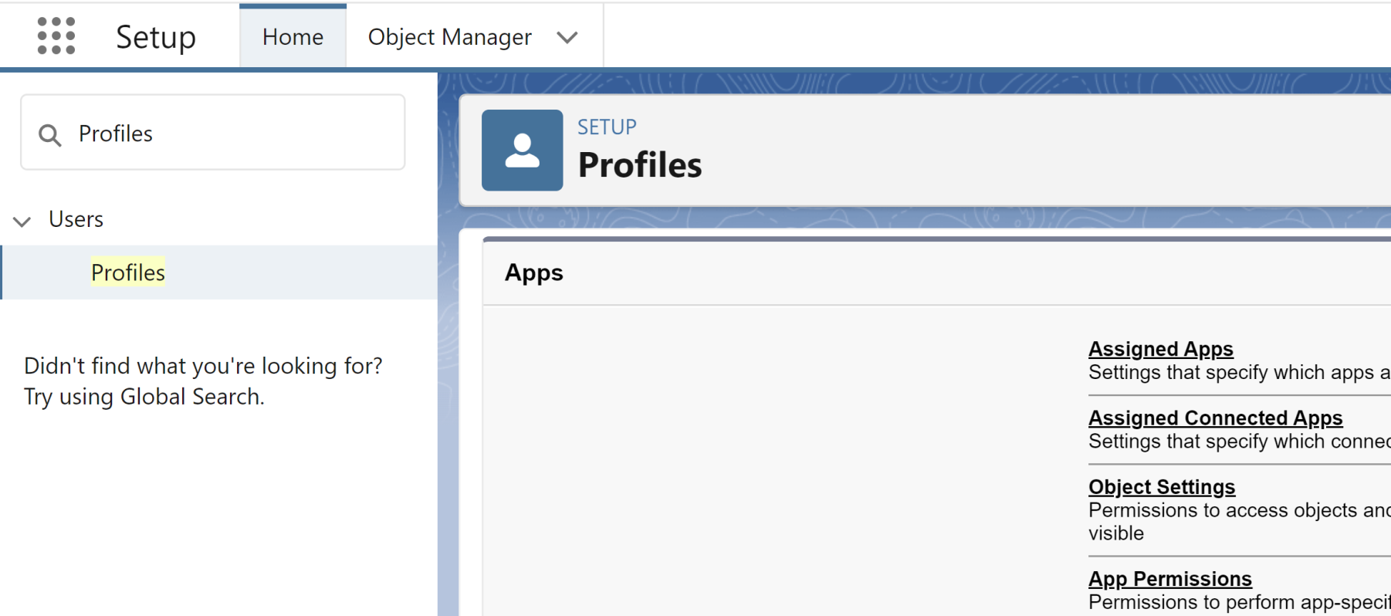
1. Open Profile Object Settings
Purpose: To enable/disable access to an object for a profile.

Slide 32
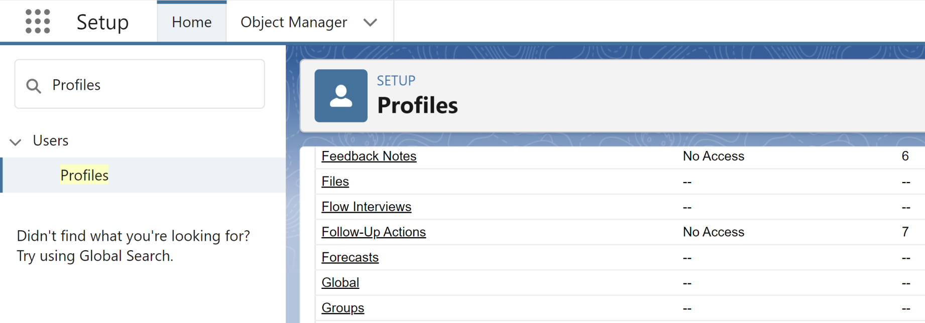
2. Open an Object

Slide 33
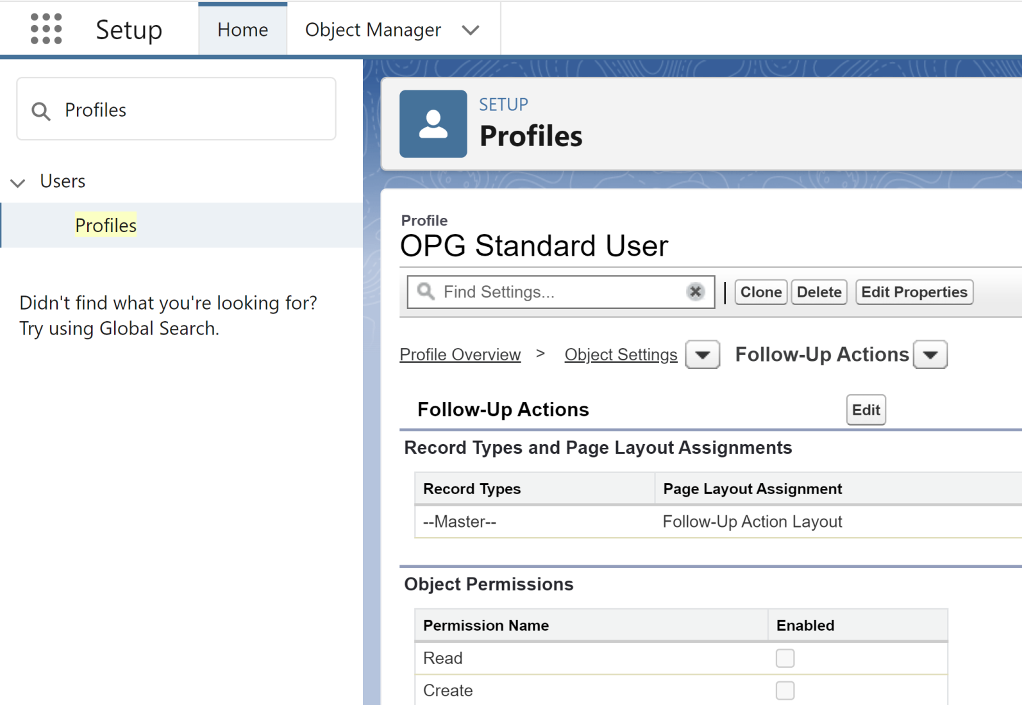
3. Edit Object Permissions

Slide 34
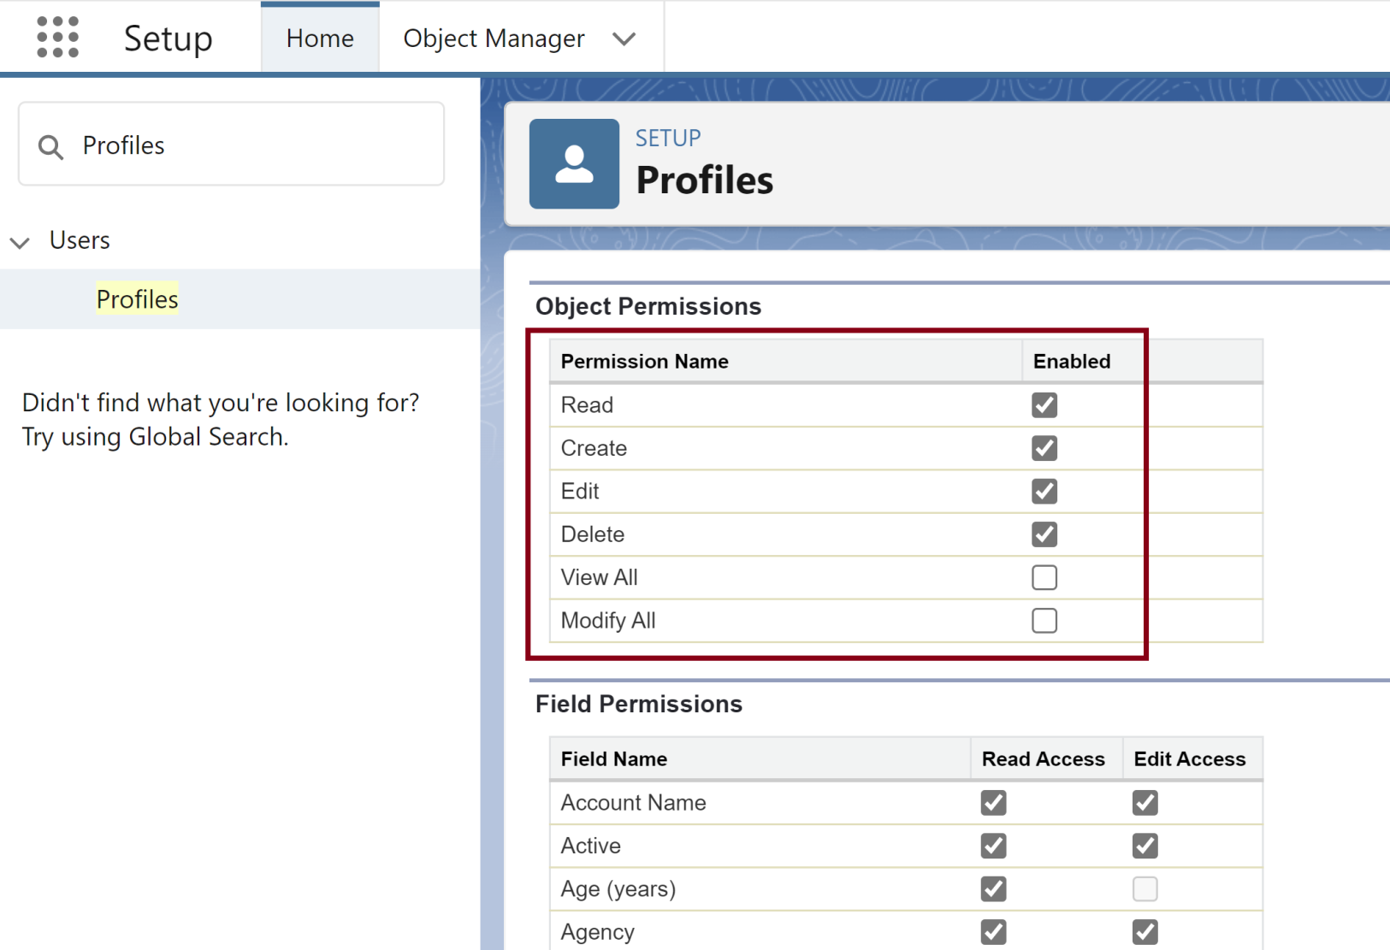
4. Modify Permissions

Slide 36
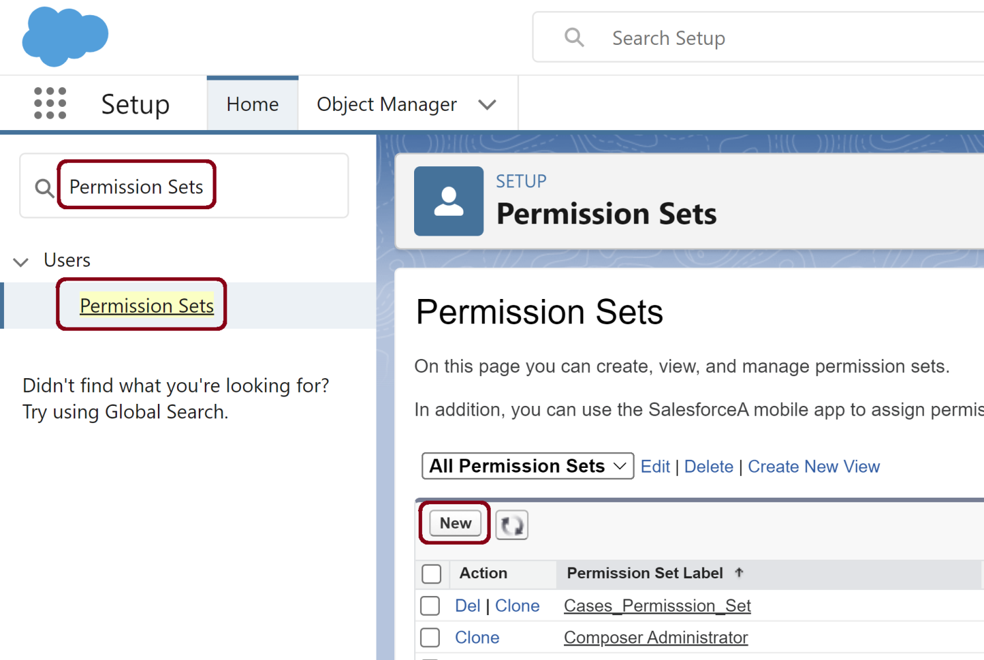
1. Create a Permission Set
Purpose: To Enable/Disable MFA for a User.

Slide 37
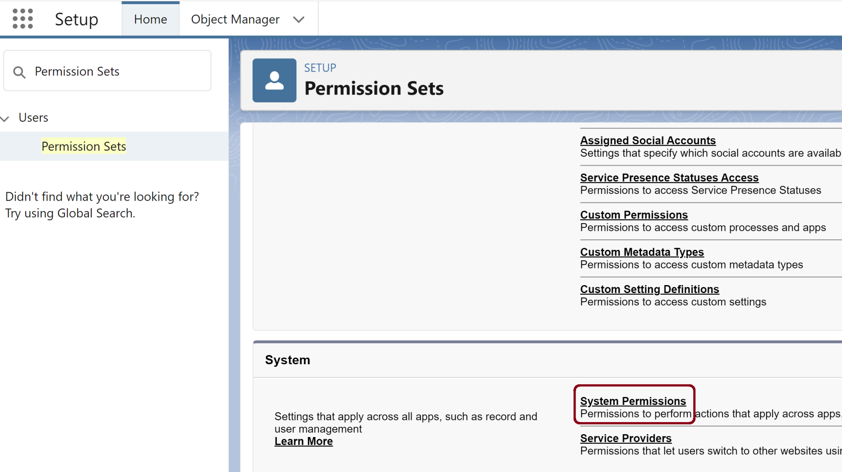
2. Edit System Permissions
Open Permission Set.
Scroll down to System Permissions. Click Edit.

Slide 38
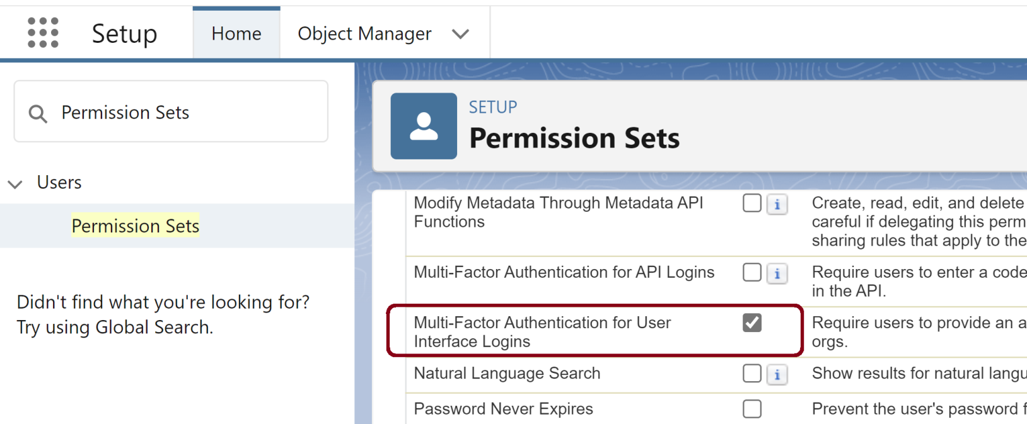
3. Select Multi-Factor Authentication for User Interface Logins

Slide 39
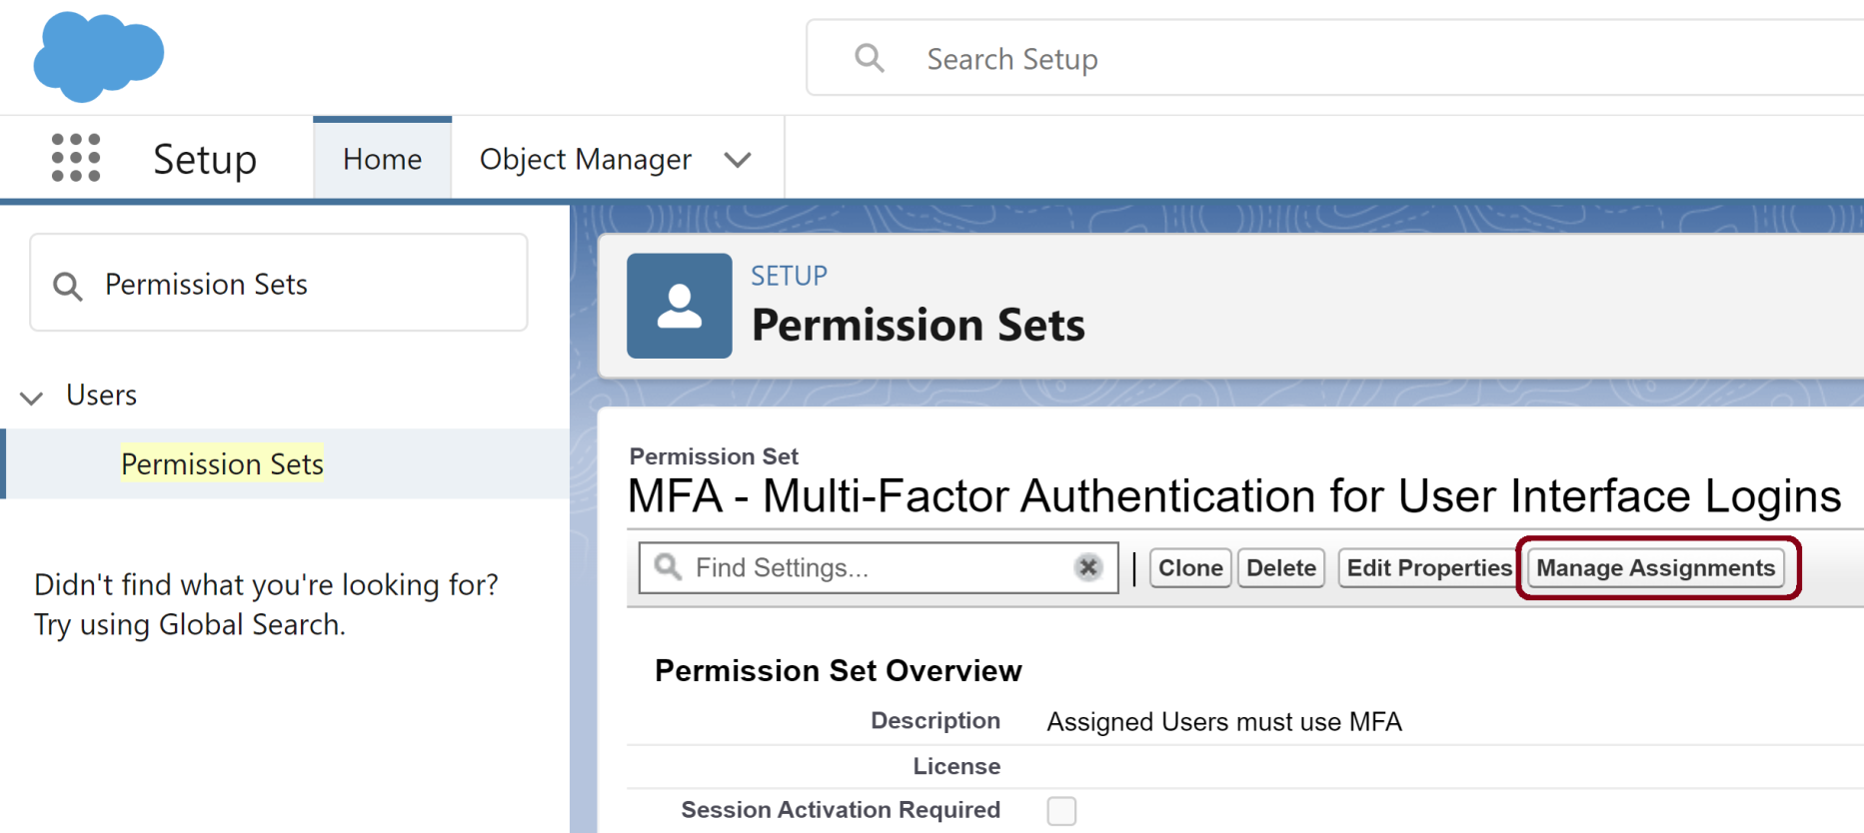
4. Go to Manage Assignments

Slide 40
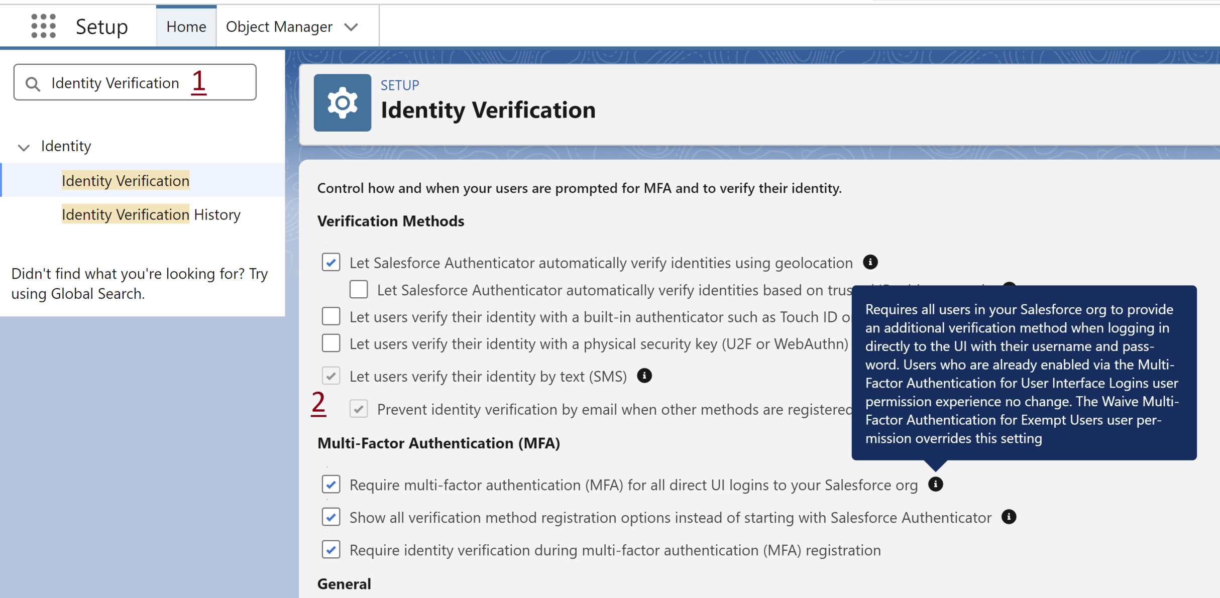
5. Review Identity Verification
Setup > Identity Verification

Slide 41
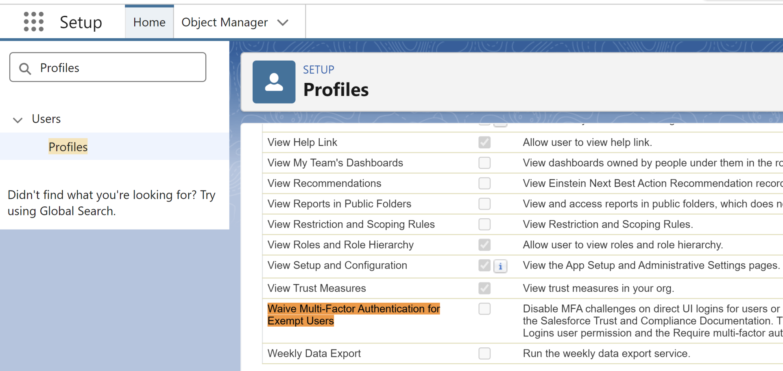
6. Review Waive Multi-Factor Authentication for Exempt Users
Setup > Profiles > [A profile] > System Permissions

Slide 42
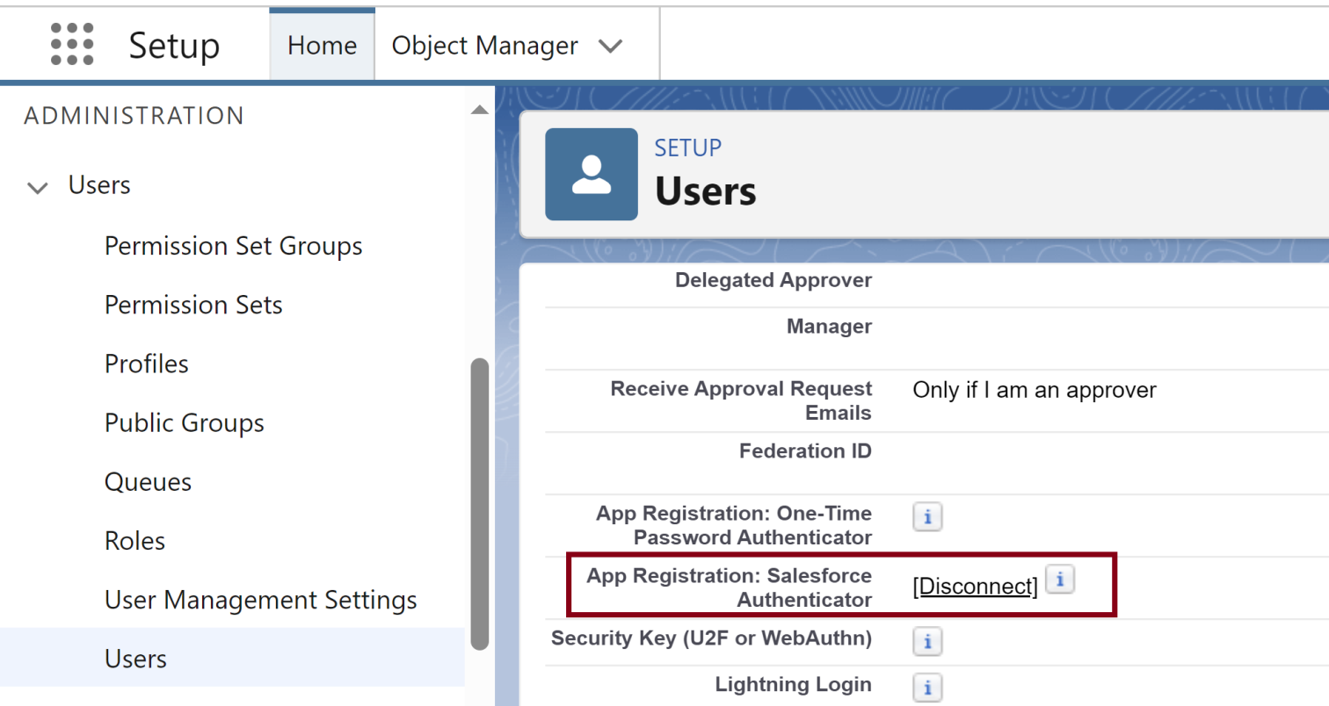
7. Disconnect Authenticator
Setup > Users > [A user]

Slide 43
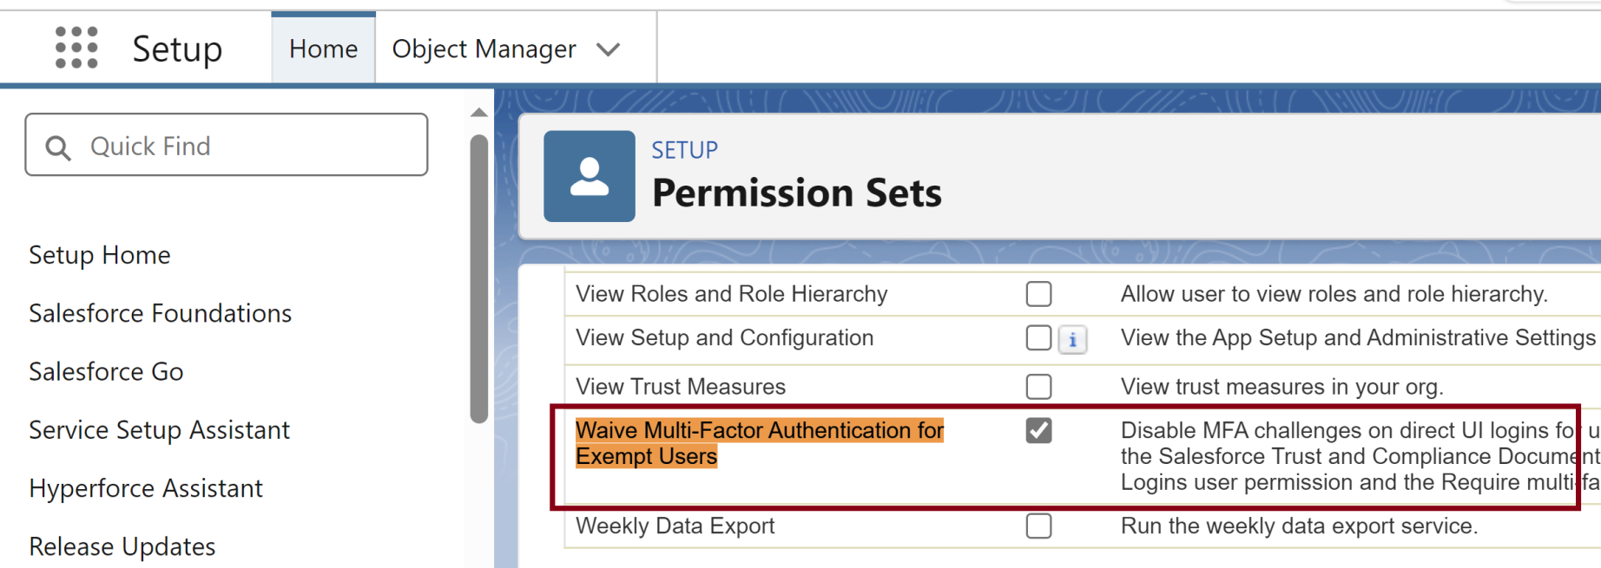
8. Allow Users to Bypass MFA
Setup > Permission Sets > New.

Slide 45
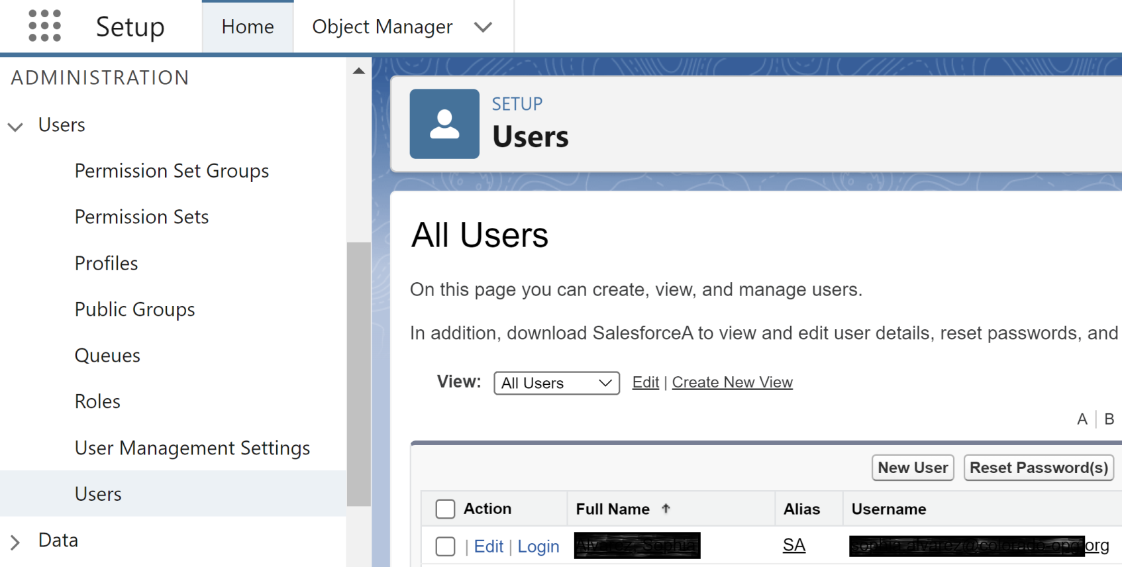
1. Log in as a User
From Setup enter Users.
Log in as a selected user.

Slide 46
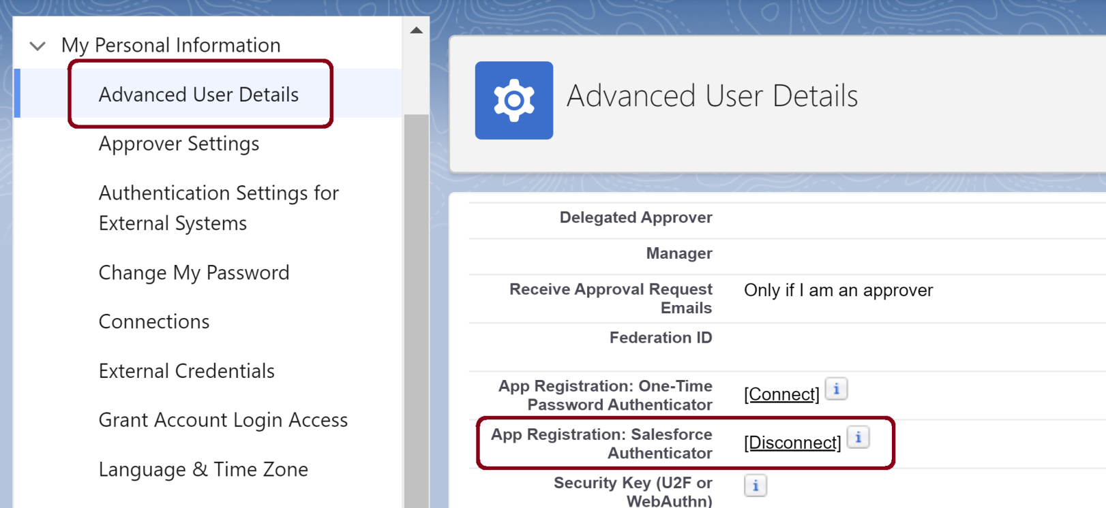
2. Self-Disconnect Authenticator
Click user's avatar > Settings > Advanced User Details.

Slide 48
Record Ownership
https://developer.salesforce.com/blogs/engineering/2013/10/behind-the-scenes-of-record-ownership-in-salesforce
Record ownership is at the core of Salesforce’s record access capabilities, which allow you to specify which users or types of users should be able to access specific records or types of records.
Salesforce.com’s architects and developers have spent years creating a highly functional and massively scalable record access infrastructure around record ownership, saving you the monumental effort of building that infrastructure yourself.
When a user creates a record, that user is identified in the record’s Owner field in the appropriate object record table. (The account object has an Account table, the opportunity object has an Opportunity table, and so on.)
At the same time, Salesforce adds a sharing record to the object’s share table, which gives record owners access to the records that they own.

Slide 49
ORG Owner
In Salesforce, all System Administrators (including the Owner, who is the first System Administrator) have equal privileges.

Slide 50
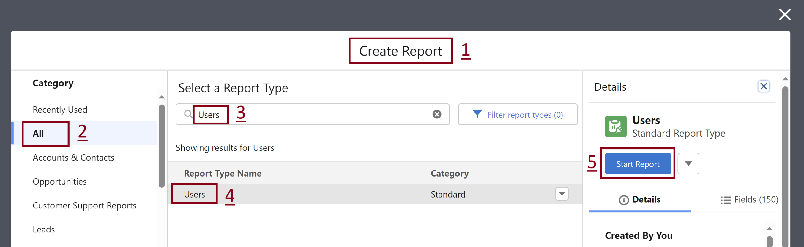
1. Create a User Login Report
From the Reports tab, click New Report.
In the Choose Report Type box, select the Users report type, then click Start Report.
Drag the desired fields into your report. Include the Login Date field.

Slide 52
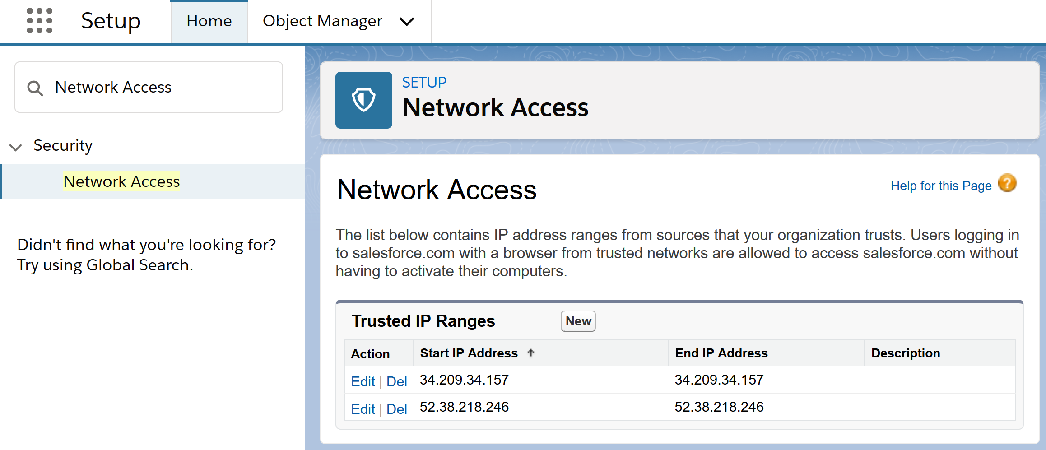
1. Configure Trusted IP Ranges
https://help.salesforce.com/articleView?id=000339699&type=1&mode=1
From Setup, enter Network Access.

Slide 53
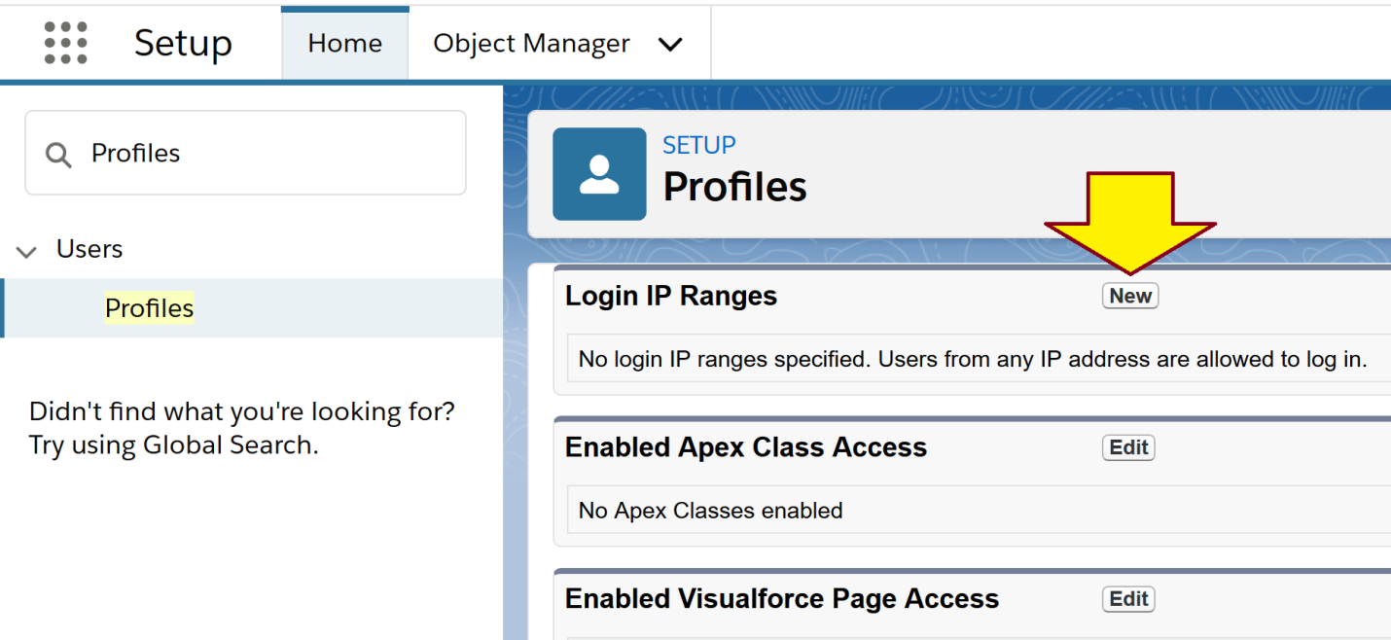
2. Restrict Login IP Ranges
https://help.salesforce.com/articleView?id=users_profiles_epui_login_ip_ranges_edit.htm&type=5
From Setup, enter Profile.
Click New button in the Login IP Ranges section.

Slide 54
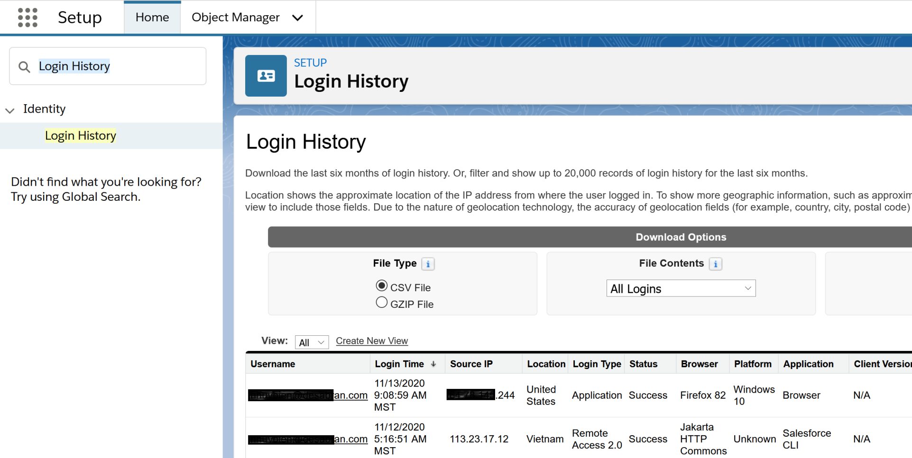
3. Review Login History
https://help.salesforce.com/articleView?id=000339118&type=1&mode=1
From Setup, enter Login History.

Slide 56
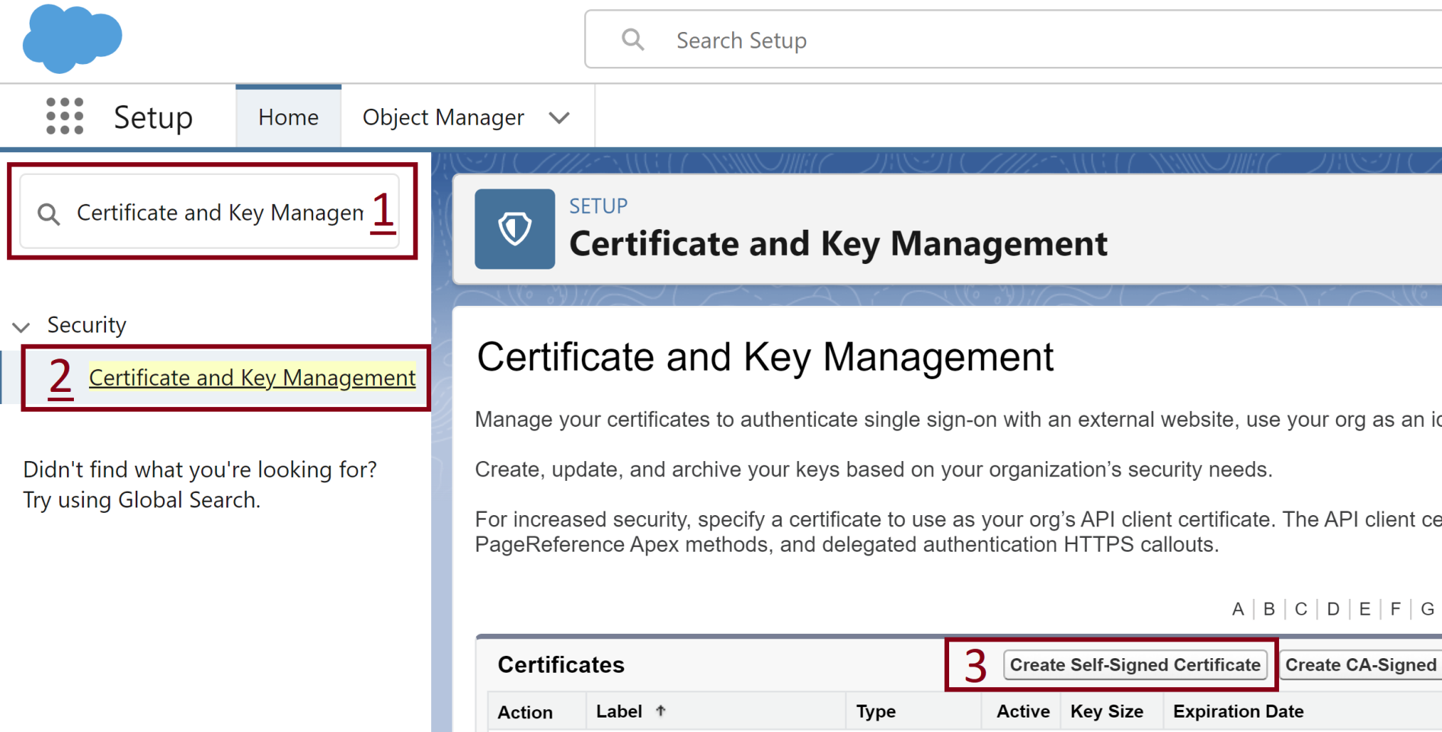
1. Generate a Certificate
From Setup enter Certificate and Key Management.

Slide 57
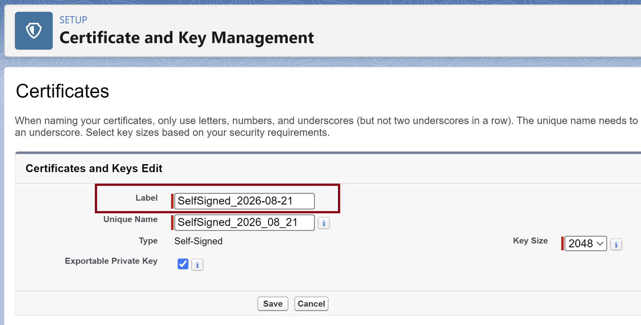
2. Enter a Label

Slide 58
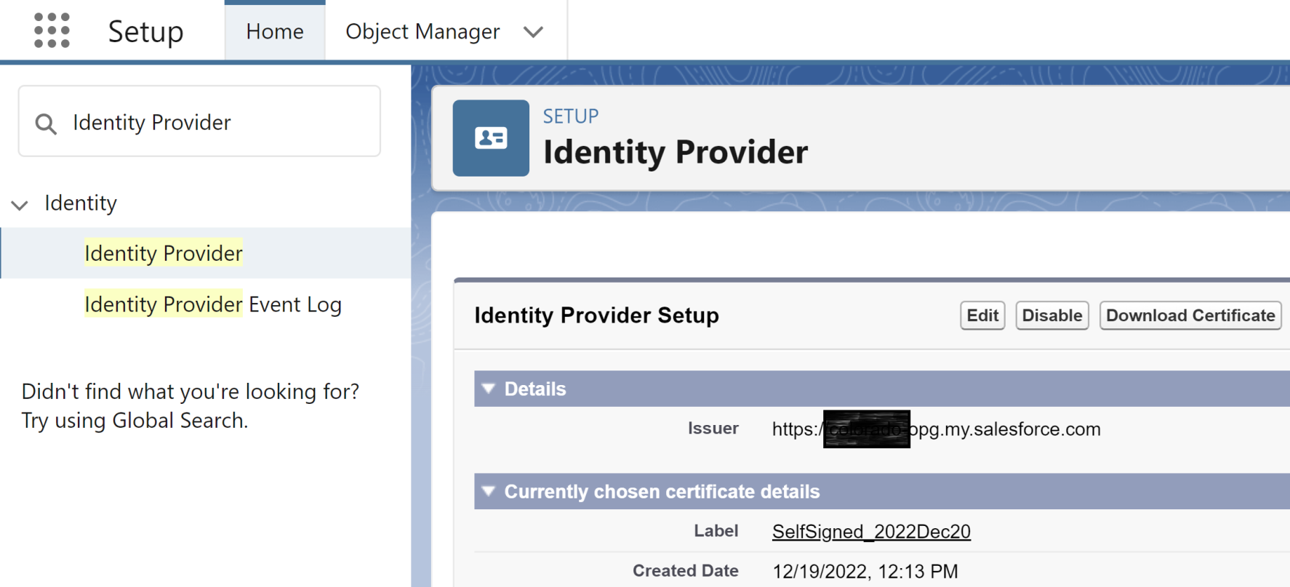
3. Use the Certificate for an IdP
From Setup enter Identity Provider.

Slide 59
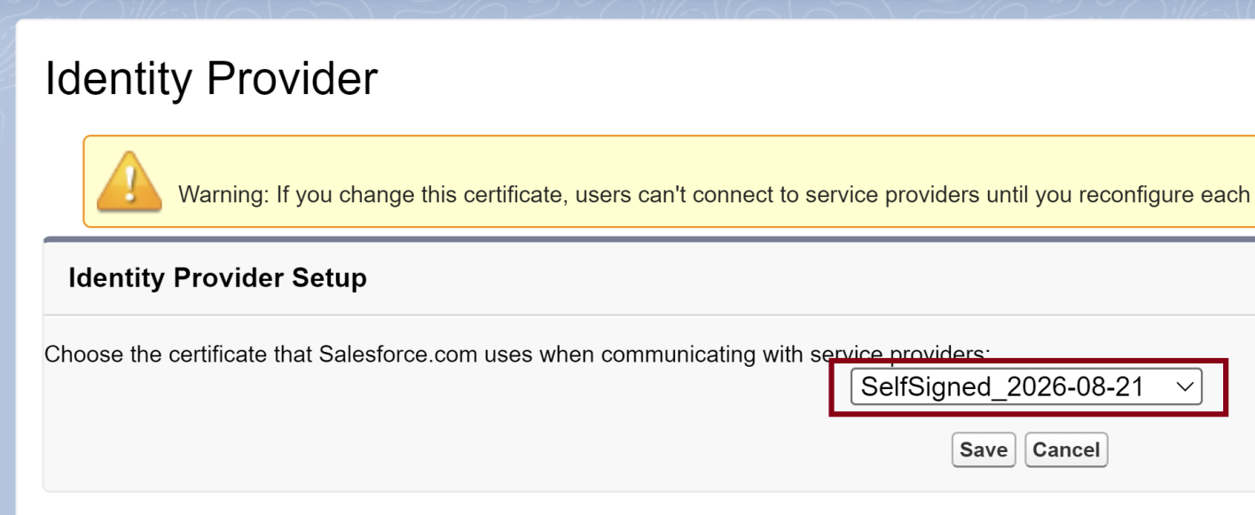
4. Select the New Certificate

Slide 60
5. Remove a Certificate
From Setup enter Certificate and Key Management.

Slide 62
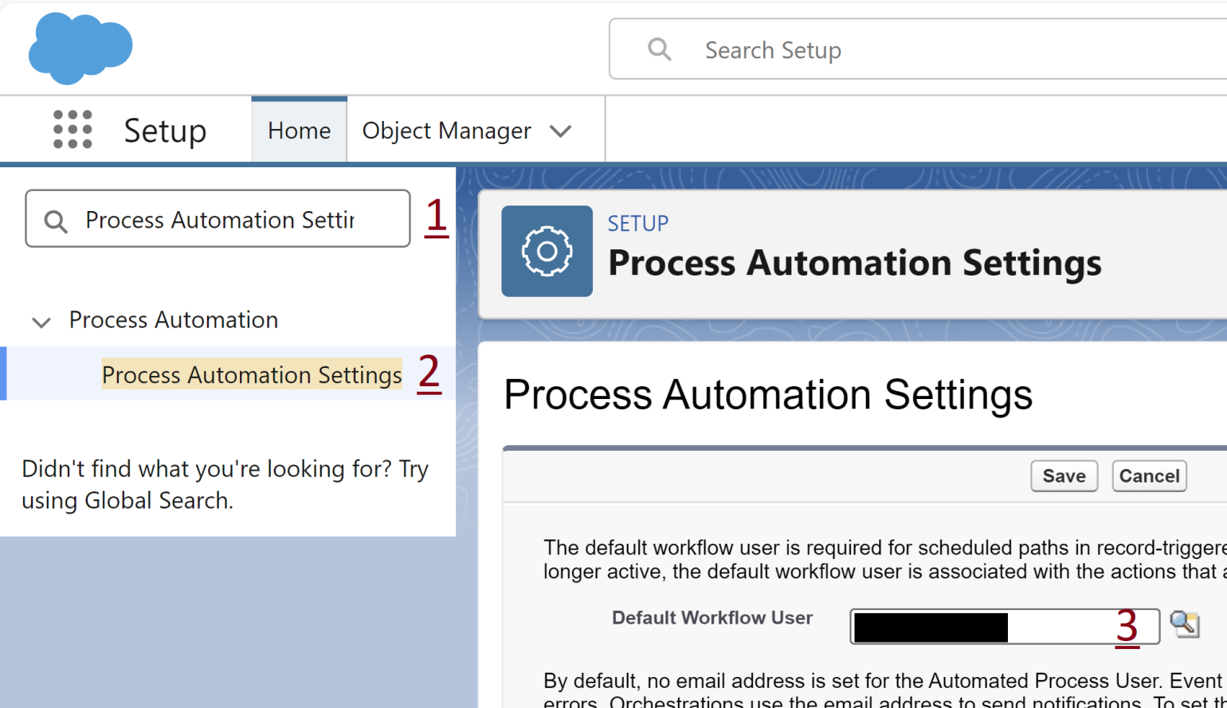
1. Change the Default Workflow User
Setup > Process Automation Settings. Purpose: To deactivate a user.

Slide 63
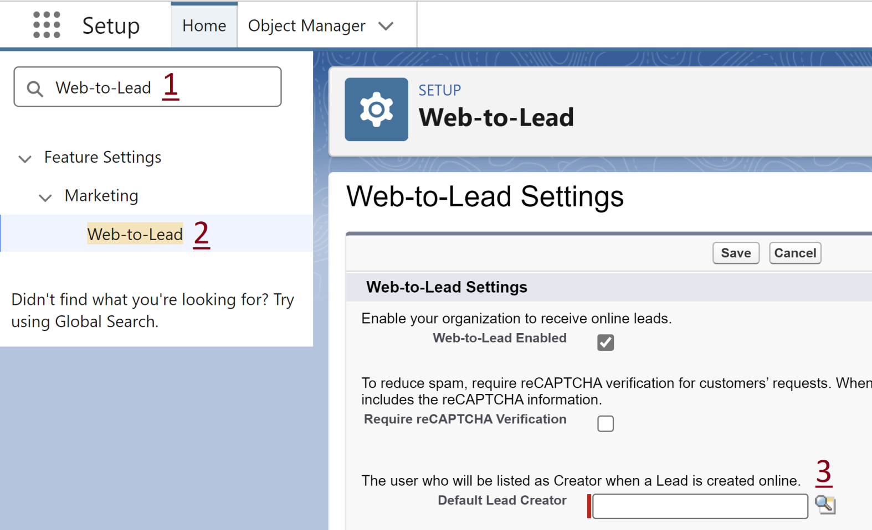
2. Change the Default Lead Creator
Setup > Web-to-Lead. Purpose: To deactivate a user.

Slide 64
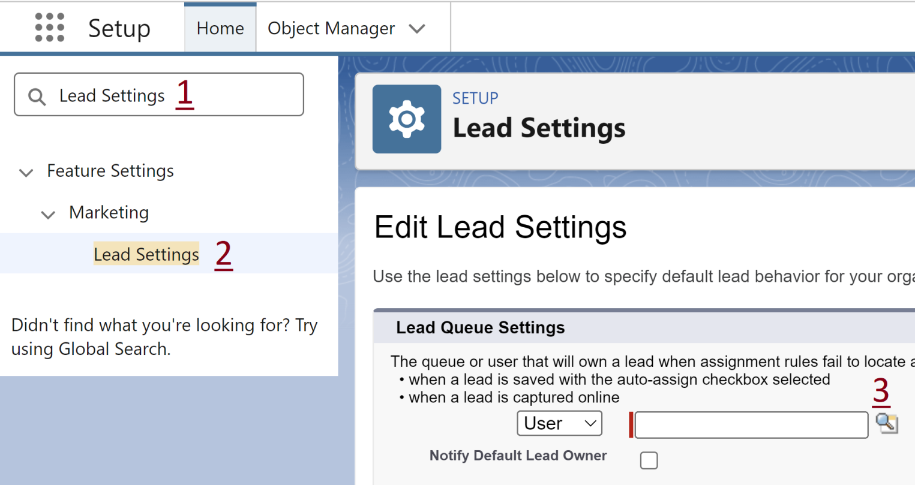
3. Change the Default Lead Creator
Setup > Lead Settings. Purpose: To deactivate a user.

Slide 65
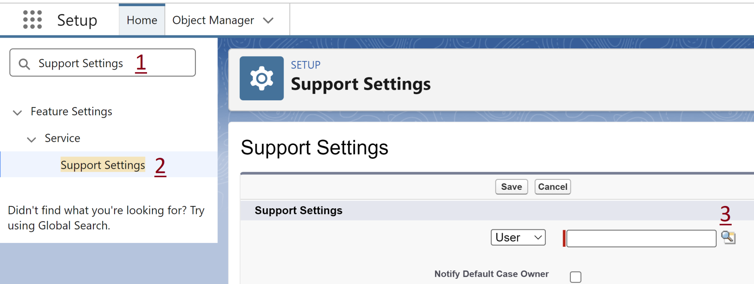
4. Change the Default Case Owner
Setup > Support Settings. Purpose: To deactivate a user.

Slide 66

Thank You & See You Again

